Slide 1

Python Programming Bootcamp - Week 3, Day 4
Error Handling and Debugging in Python
Atta Muhammad
attapanhyar@quest.edu.pk
+923331971110
Quaid-e-Awam University of Engineering, Science and Technology

Slide 2
Learning Objectives
Understand Python's error types and common debugging strategies.
Learn how to handle exceptions using try, except, finally blocks.
Apply error handling in Python programs.
Explore debugging techniques to identify and fix errors.

Slide 3

Types of Errors in Python
Syntax Errors: Occur when the code violates Python's syntax rules.
Runtime Errors: Errors that occur while the program is running, like division by zero.
Logical Errors: Errors that cause the program to behave incorrectly, without crashing.

Slide 4
Introduction to Exception Handling
Definition: Exceptions are events that can alter the normal flow of a program.
Why Handle Exceptions?: To prevent the program from crashing and to provide informative feedback to users.

Slide 5
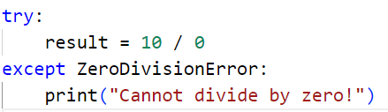
try, except, and finally Blocks

Slide 6
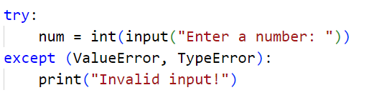
Handling Multiple Exceptions

Slide 7
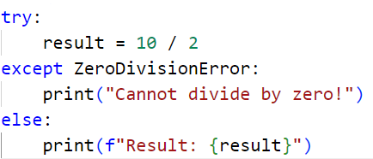
The else Clause in Exception Handling
Definition: Executes if no exceptions are raised in the try block.

Slide 8

Raising Exceptions
You can raise your own exceptions using the raise keyword.

Slide 9
Hands-On Exercise 1
Task: Write a Python program that takes input from the user and raises an exception if the input is not a number.

Slide 10
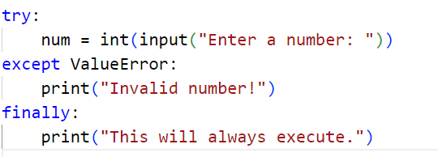
The finally Clause

Slide 11
Debugging Techniques
Print Debugging: Use print() statements to understand the flow of the program.
Using Breakpoints: Set breakpoints in your IDE to pause execution and inspect variables.
Logging: Use Python's logging module to keep track of events and errors in a file.

Slide 12
Hands-On Exercise 2
Task: Write a Python program that divides two numbers. Handle division by zero and other invalid inputs using try-except.

Slide 13

Debugging with assert
Definition: assert statements check if a condition is true, raising an AssertionError if it is false.

Slide 14
Using the pdb Module for Debugging
Definition: pdb is Python's built-in debugger.

Slide 15
Hands-On Group Activity
Task: Create a Python program with intentional errors. Debug it using the techniques learned today.

Slide 16
Recap and Key Takeaways
Key Points:
Exceptions help handle runtime errors without crashing the program.
The try-except block is essential for error handling.
Debugging involves identifying errors and finding solutions efficiently.

Slide 17
Q&A

Slide 18
MATCH THE SOLUTIONS 😒

Slide 19
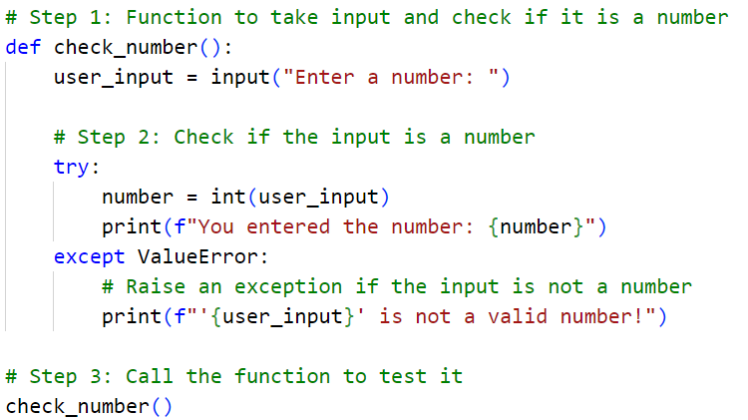
EXERCISE 😊

Slide 20
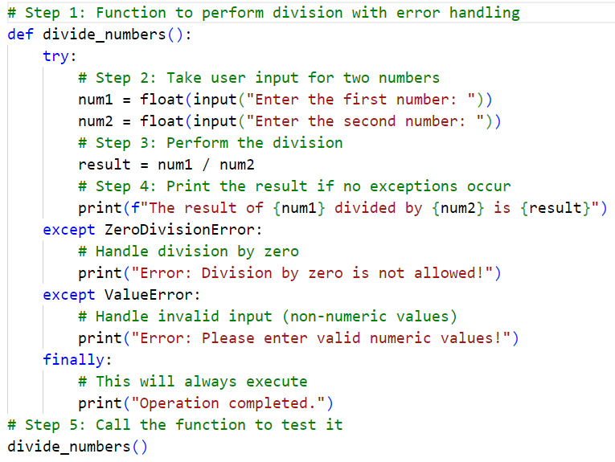
EXERCISE 🫥

Slide 21
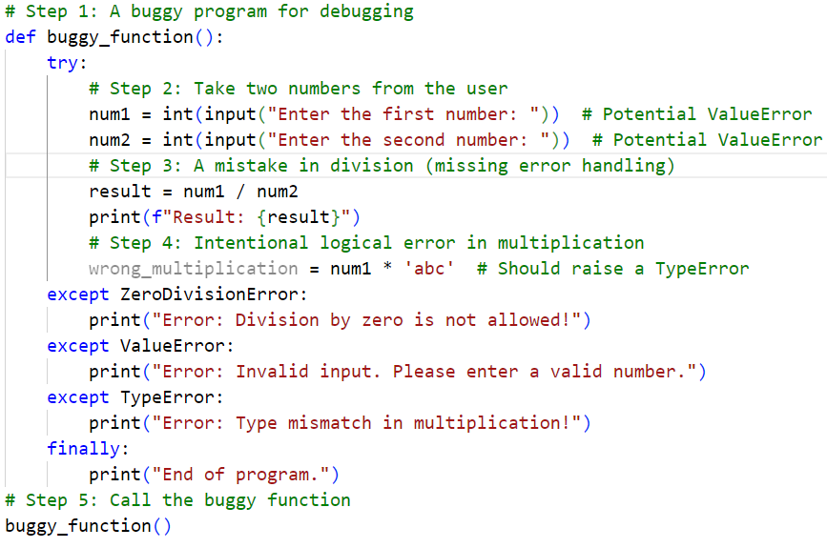
EXERCISE 💎

